Slide 1

Campus Sport Resources
A Command-Line Inventory System for University Athletics
Built with C • MySQL • Docker | August 2026

Slide 2

The Challenge
The Problem
University sports departments manage hundreds of equipment items — balls, rackets, cones, nets, whistles. Tracking what's available, where it's stored, and who can access it is often done with spreadsheets or paper logs. This leads to lost equipment, double-bookings, and wasted budget.

Slide 3
Our Approach
A lightweight, fast command-line application that puts inventory control at the user's fingertips. No bloated interfaces — just quick, reliable access to what matters.
Track Everything
Control Access
Deploy Anywhere
Every item has a digital record with location, quantity, and availability status.
Two user roles: Admins manage the system, regular users browse and update.
Packaged in Docker, it runs identically on any machine — classroom PC, personal laptop, or cloud server.

Slide 4
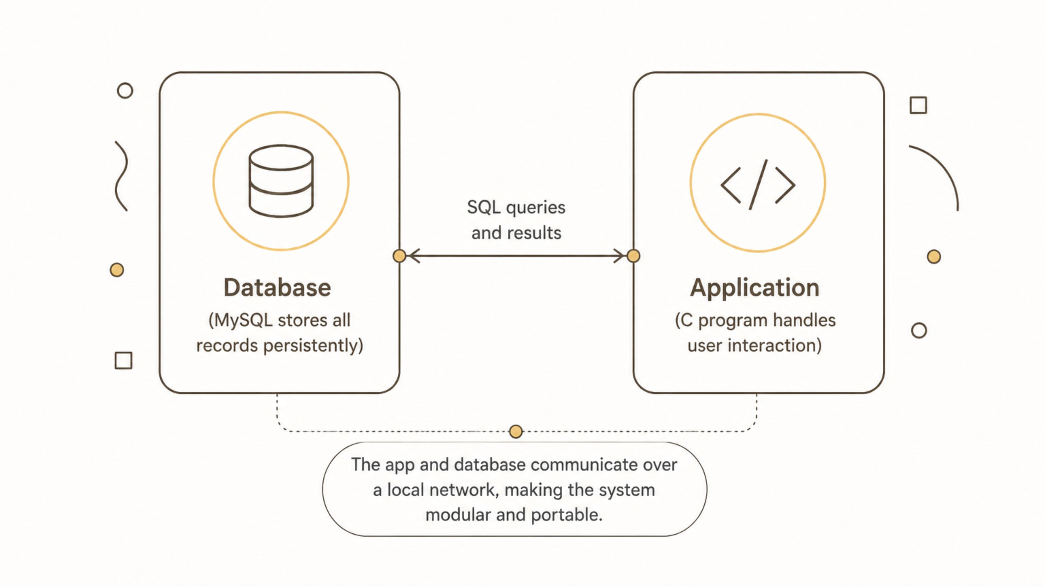
How It Works
The app and database communicate over a local network, making the system modular and portable.

Slide 5
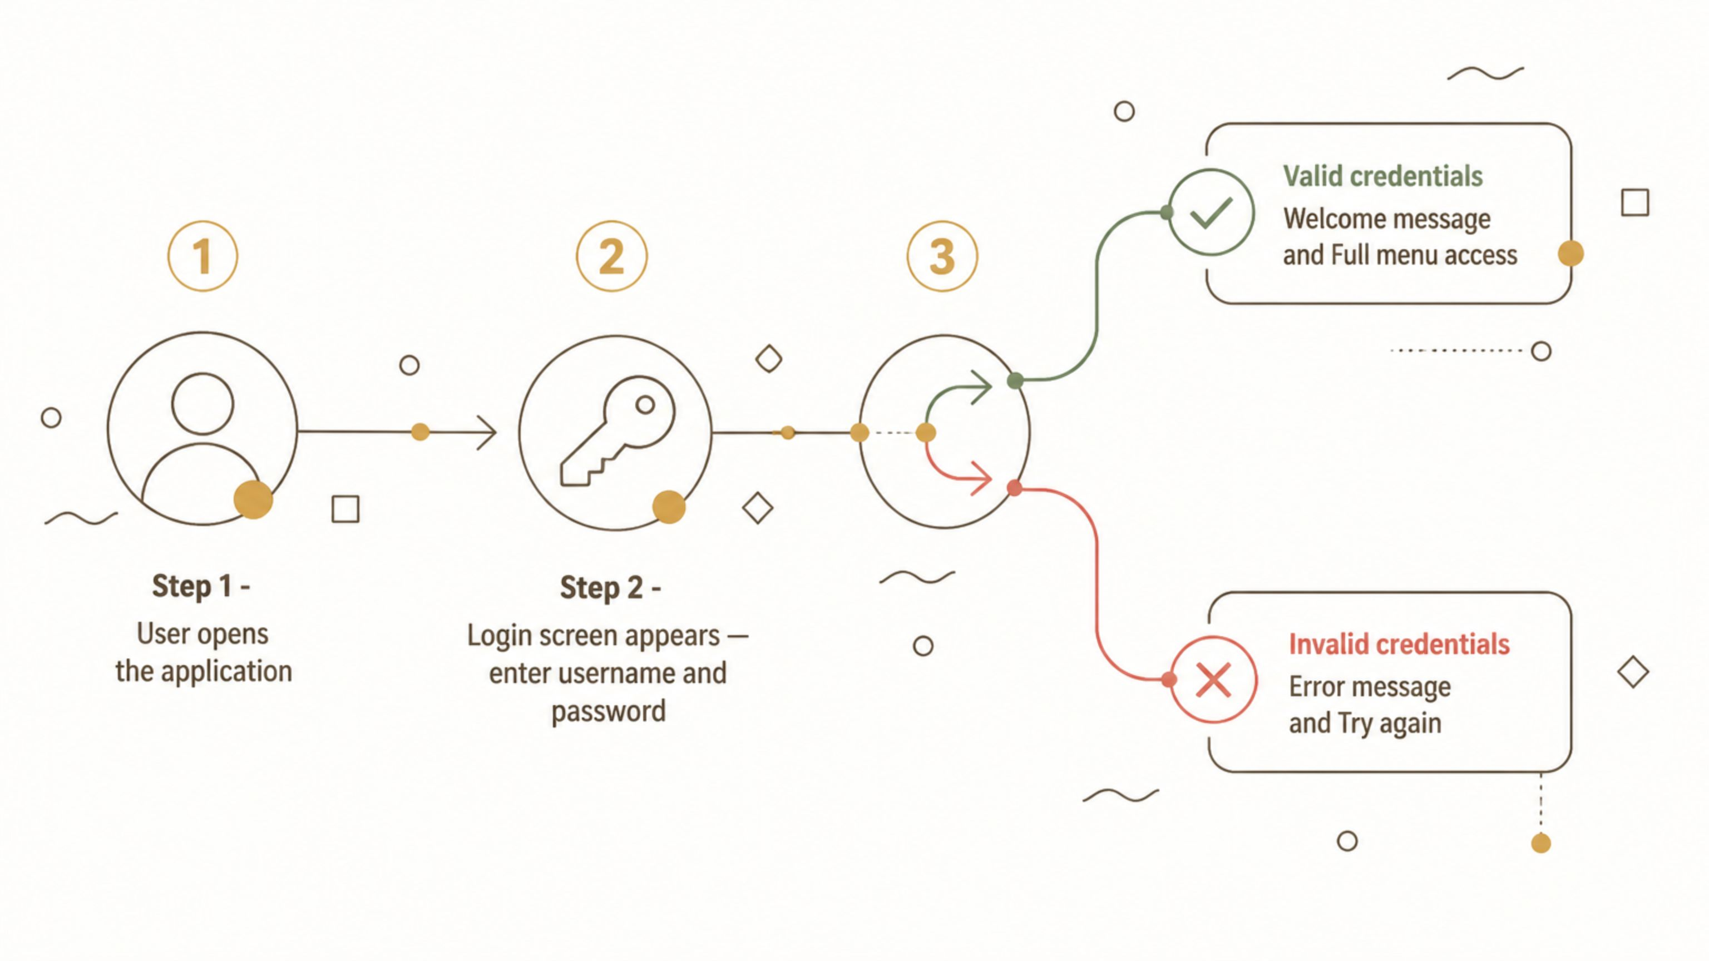
Getting Started
Security starts at the door. Only verified users enter the system.

Slide 6

At Your Command
Terminal Menu
Logged in as: admin [Admin] 1. Create Resource 2. List All Resources 3. Find One Resource 4. Update Resource 5. Delete Resource 6. Register New User [Admin only] 0. Logout
Role-based menus ensure users only see what they're allowed to do.

Slide 7
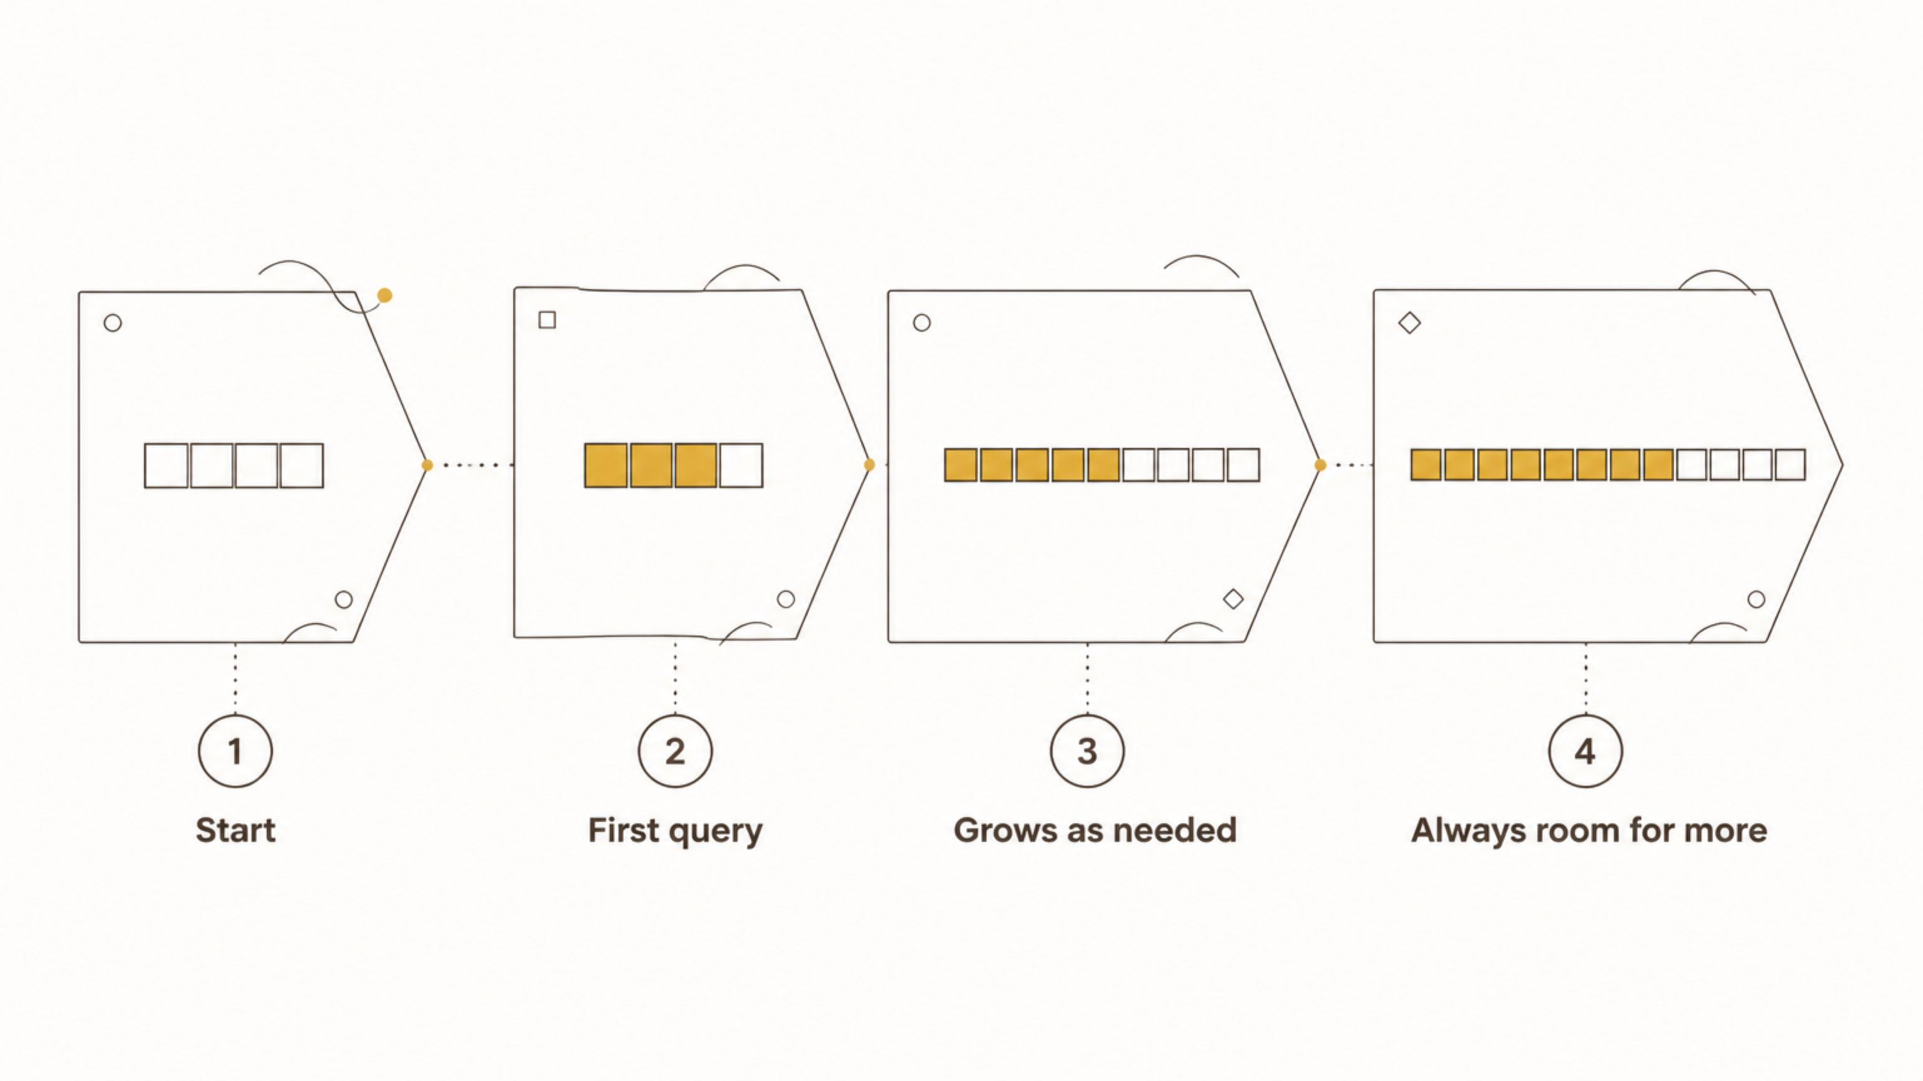
Smart Memory Management
The system doesn't know in advance how many records the database holds. Instead of wasting memory with fixed arrays, it starts small and grows automatically — doubling capacity whenever space runs out.
Like a backpack that expands when you need it.

Slide 8

Run Anywhere
Setting up databases and compilers on different computers is frustrating. Docker solves this by packaging the entire environment — operating system, dependencies, and configuration — into a single container.
One command, any platform. No "it works on my machine" excuses.

Slide 9
What We Built
6
2
1
Core Operations
User Roles
Command
Create, Read, Read All, Update, Delete, Register
With distinct permissions
To deploy anywhere
Beyond the numbers, this project demonstrates understanding of systems programming, database design, memory management, and modern DevOps practices — skills that transfer directly to professional software engineering.

Slide 10


Built for Real-World Problems
From classroom concepts to working software.
Campus Sport Resources proves that even 'old school' tools like C and the command line, when combined with modern practices like containerization, can solve contemporary problems elegantly and efficiently.
Questions?

